Slide 1
Zowe Mobile Application
Jessielaine Punongbayan
Richelle Anne Craw
David Janda
Marketa Muzikova
15 January 2020

Slide 2
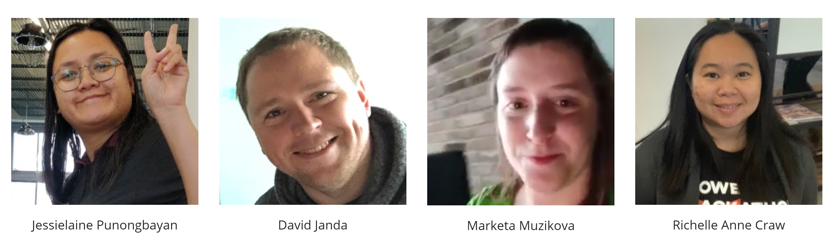
Why mobile app?
Where do we start?
Who is our persona?
Notes:
Ctrl+Z Team Intro
Why Mobile App:
Ask who here has a smart phone?
Did you know that consumers downloaded 194 billion mobile applications in 2018? There’s no wonder that there has been a lot of talk about the Application Economy in recent years. Having a mobile application for any service is becoming non-negotiable. Mainframe services are no exception.
Where does the problem lie?
- The possibilities for the functionalities we can implement are endless. The challenge is actually to limit the scope. So the real question is….
Who is our persona?
- It’s a good thing our team has experience working for Mainframe Global Service Providers, performing 24x7 on-call support for mainframe applications and jobs, as well as providing systems and operations support.
Drawing from this experience, we were able to construct a use case for a mobile application with sufficient features for early adopters.
<Introduce Kristina>
"As an on-call support, my immediate needs are to check the status of running services and to perform a number of jobs services: get a list of jobs, get content from a job file output, submit a job, and more."

Slide 3
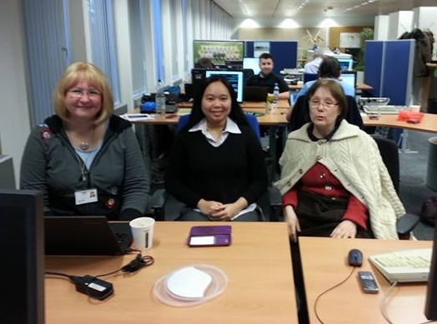
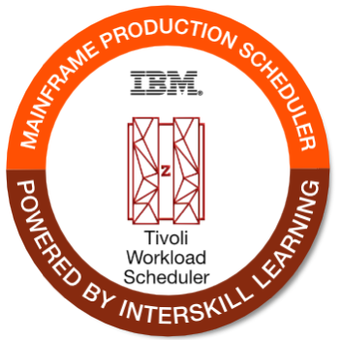
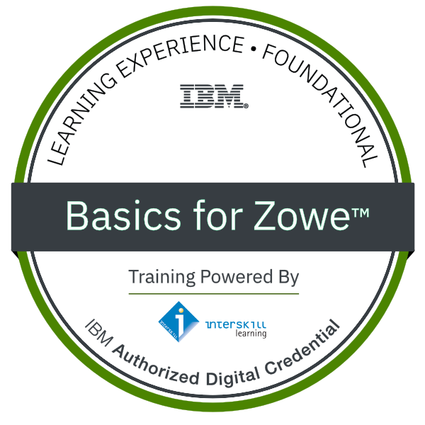
Persona Interview
Kristina (Production Scheduler)
Role / Responsibilities:
Creates and maintains job definitions, schedules, and job streams
Promotes jobs into Production, sending events to jobs (such as putting jobs on hold before planned maintenance), and resolves issues with jobs that are not working properly
On-call support for Production batch processing
Challenges:
Long running and critical Production jobs need constant monitoring
Even for known issues, it takes 30 minutes or more to solve
When on-call, info from L1 is insufficient to provide a quick overview, login to workstation is needed for more information
Time-triggered jobs are usually scheduled in the middle of the night, login to workstation is needed for checking status
Expertise: Expert knowledge of Workload Automation, related to jobs

Slide 4
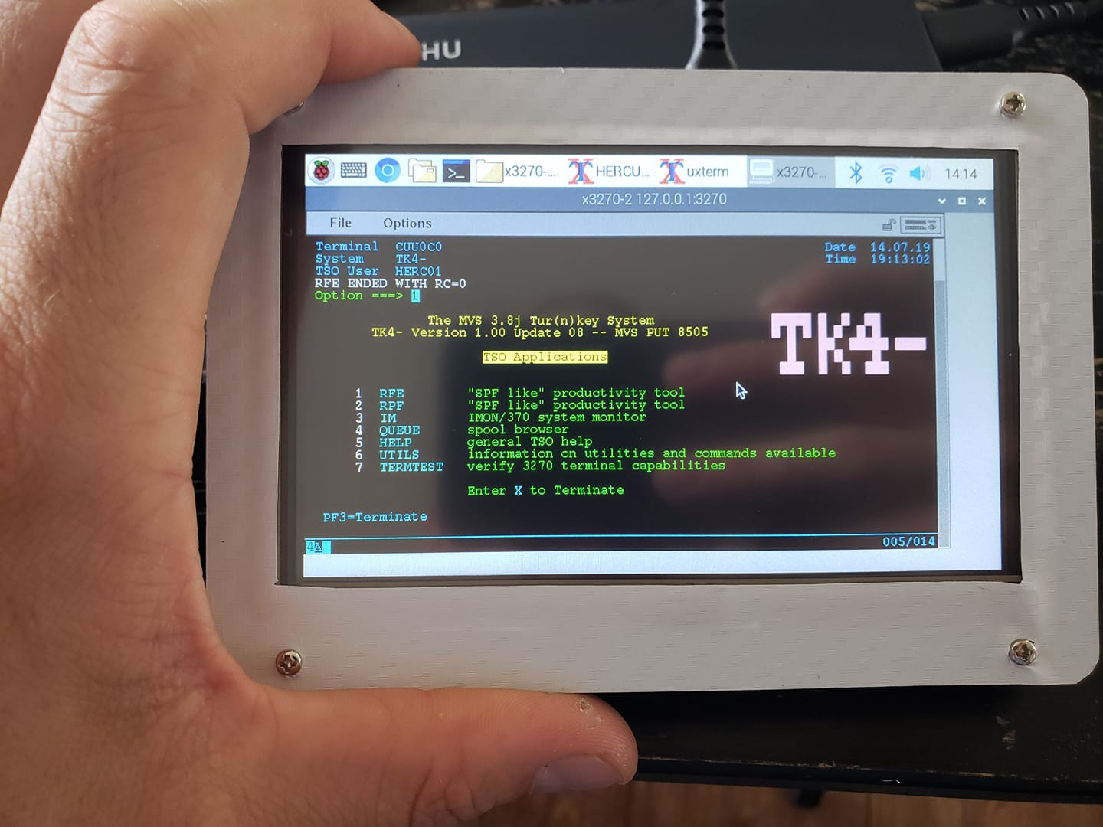
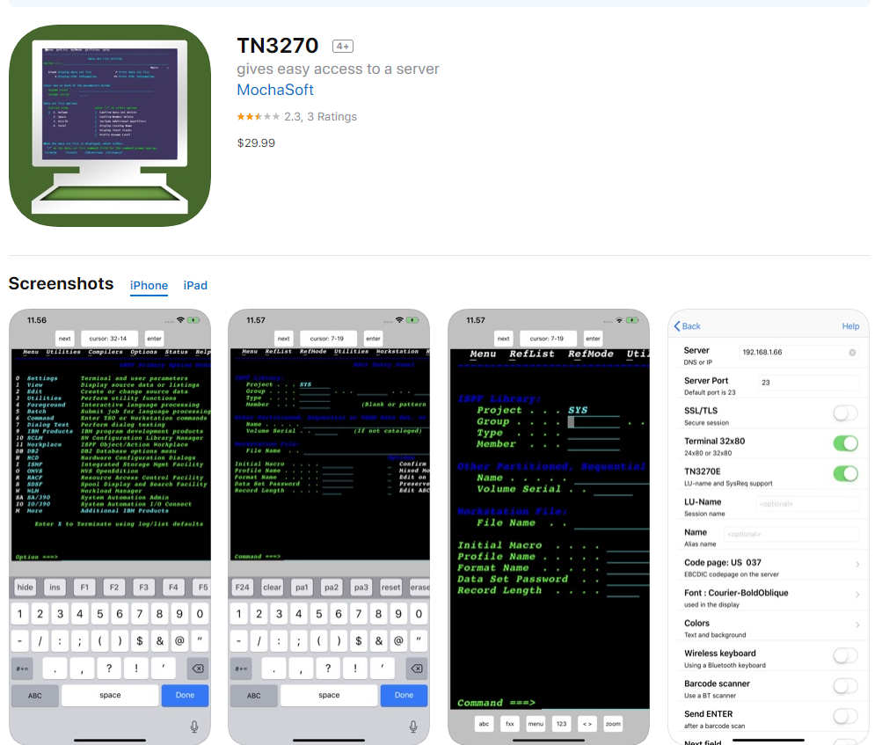
Current Market Offerings
Mainframe in Raspberry Pi
3270 Emulator in IOS
Notes:
green screen is not preferable for mobile use

Slide 5
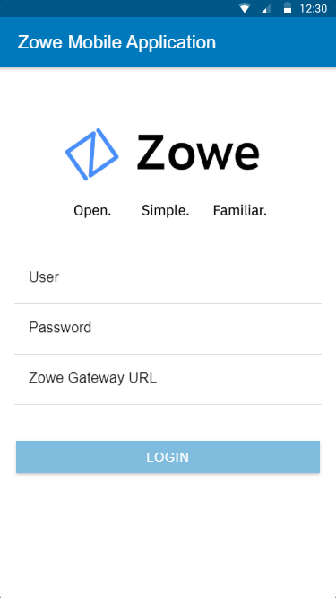
MEET THE ZOWE MOBILE APPLICATION
The Zowe Mobile Application enables users to interact with Zowe, while on the go.
It uses Zowe RESTful APIs to access:
the API Mediation Layer Gateway
z/OS Jobs Services
Zowe: Open, Simple, Familiar, and Mobile!

Slide 6
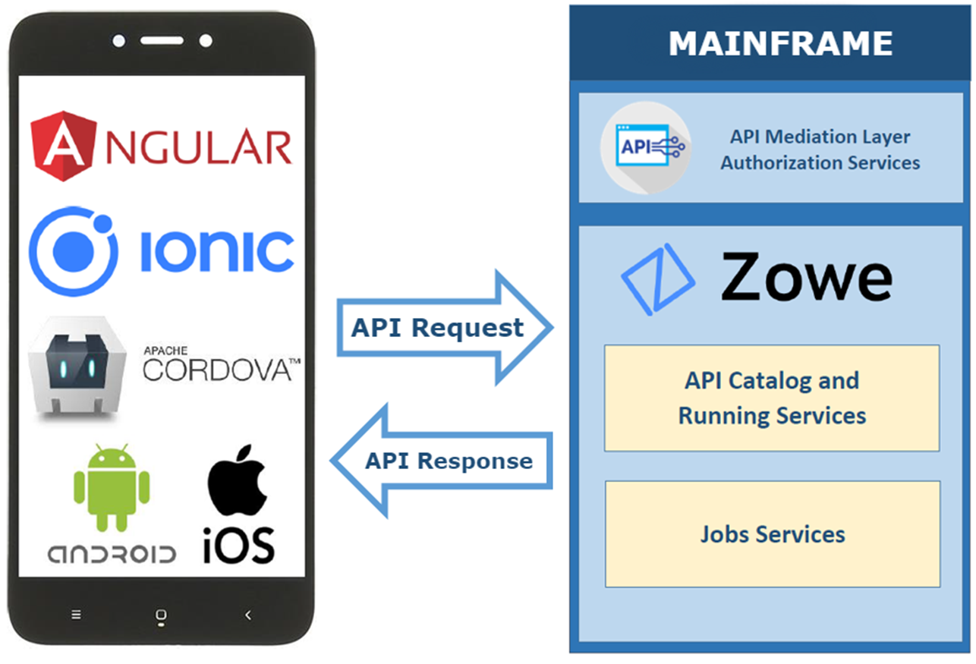
TECHNOLOGY STACK
Zowe
Zowe API Mediation Layer
Zowe z/OS Jobs services
Ionic
Apache Cordova
Angular
Other useful tools:
Git
Node.js
Code editors
VSCode
PyCharm
Figma
Notes:
Zowe
Zowe API Mediation Layer – The Single Sign On (SSO) as well as the access to dynamically discovered z/OSMF REST APIs and z/OS services provides the core functions we need. The high-availability and scalability features of the API Mediation layer gives confidence that the Zowe instance is able to handle multiple mobile requests.
Zowe z/OS Jobs services – The full list of capabilities of the RESTful APIs can be exploited for the management of z/OS JES jobs.
Ionic – This is the development framework that provides the UI toolkit for building the mobile application.
Apache Cordova is leveraged by Ionic to build and deploy the code as a native application.
Angular – This is the development platform for building the mobile application in HTML and Typescript.
Other useful tools:
Git for version control and project kanban board
Node.js for interacting with the Ionic ecosystem
Code editors with built in terminal (We used VSCode and PyCharm) for writing code and for running the Ionic CLI commands.
Figma for prototyping the UI and workflow
Why Ionic and Angular?

Slide 7
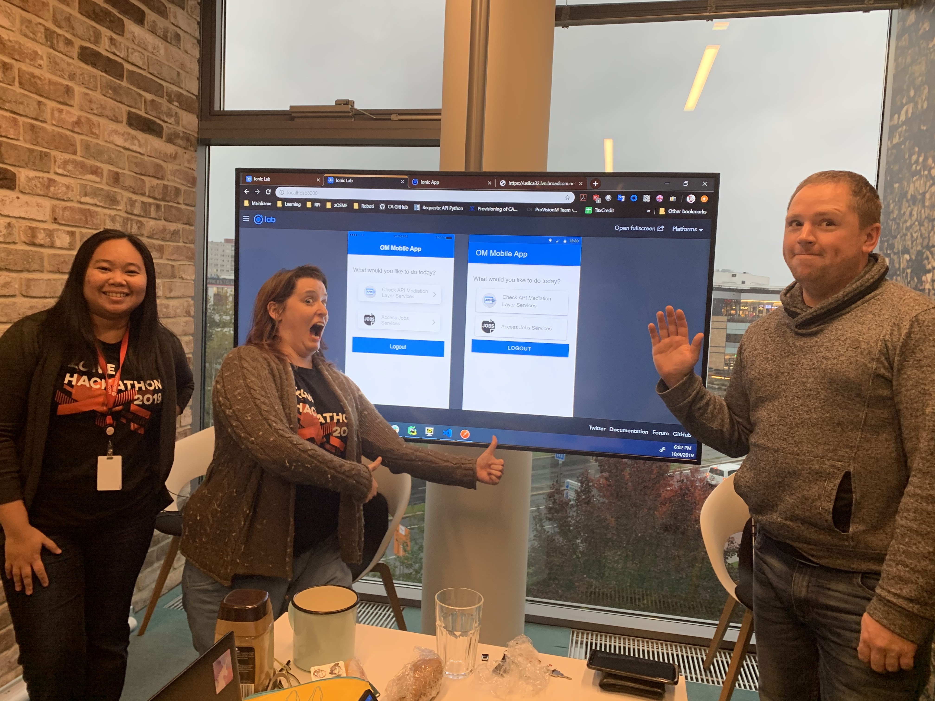
Development Process
To get started, we went through the following steps:
Install the Ionic CLI: npm install -g ionic
Clone the repository consisting of empty pre-made app templates: git clone https://github.gwd.broadcom.net/jp669971/Mainframe-Mobile-App.git
Install the dependencies from the /app directory: npm install
Run the local development server: ionic serve --lab
Code and Debug (F12)
Notes:
The emulators were very helpful during the development process

Slide 8
Demo

Slide 9
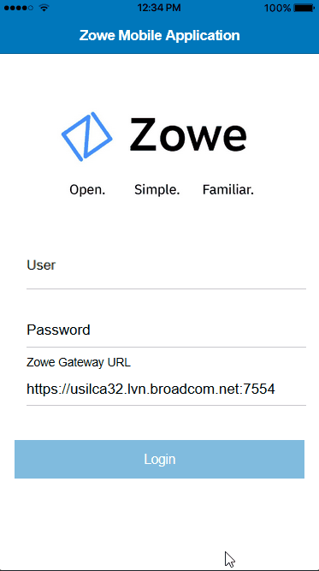
Completed Use Cases
Login using mainframe credentials
Check the status of all the Zowe services discovered by the API Mediation Layer
Access the running z/OS Jobs services and z/OSMF REST APIs to:
Filter jobs
View job spool
Restart jobs
Edit JCL from spool and submit the job
Delete jobs from spool
Cancel running jobs

Slide 10
Q & A

Slide 11
Thank you!

